Slide 1
HBase
By
Prof. Prakash Patel
Asst.Prof.-it dept.
git

Slide 2
What is HBase?
HBase is a distributed column-oriented database built on top of the Hadoop file system.
It is an open-source project and is horizontally scalable.
HBase is a data model that is similar to Google’s big table designed to provide quick random access to huge amounts of structured data.
It is a part of the Hadoop ecosystem that provides random real-time read/write access to data in the Hadoop File System.

Slide 3
One can store the data in HDFS either directly or through HBase.
Data consumer reads/accesses the data in HDFS randomly using HBase.
HBase sits on top of the Hadoop File System and provides read and write access.

Slide 4
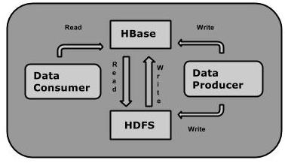
Architecture of HBase
The following component diagram depicts the architecture of HBase:

Slide 5
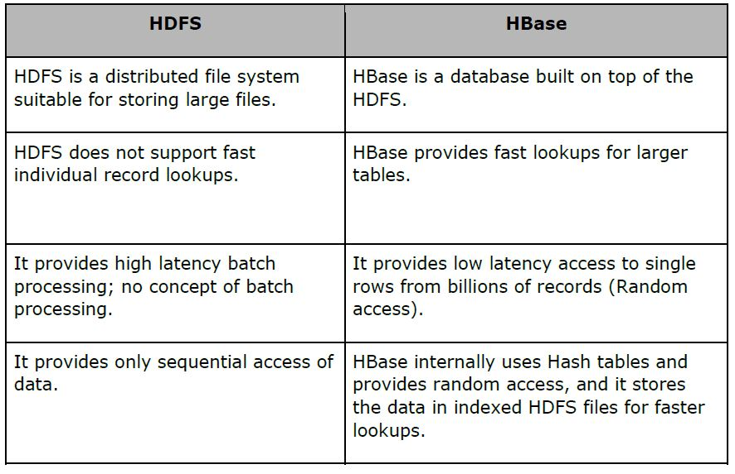
HBase and HDFS

Slide 6
Storage Mechanism in HBase
HBase is a column-oriented database and the tables in it are sorted by row.
The table schema defines only column families, which are the key value pairs.
Table is a collection of rows.
Row is a collection of column families.
Column family is a collection of columns.
Column is a collection of key value pairs.

Slide 7
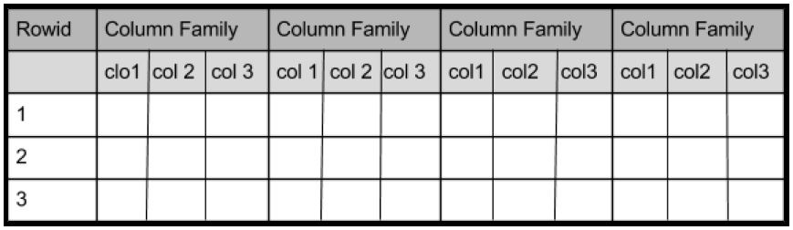
Given below is an example schema of table in HBase.

Slide 8
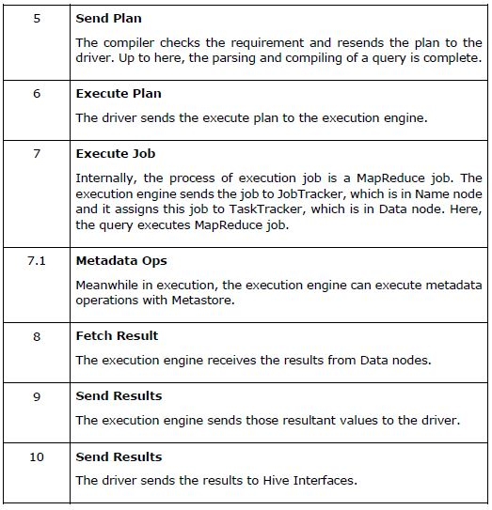
continue

Slide 9
HIVE Data Types
All the data types in Hive are classified into four types, given as follows:
1. Column Types
2. Literals
3. Null Values
4. Complex Types

Slide 10
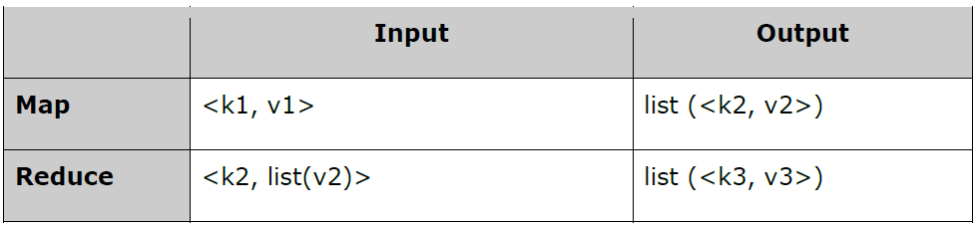
MapReduce I/O
Input and Output types of a MapReduce job: (Input) <k1, v1> -> map -> <k2, v2>-> reduce -> <k3, v3> (Output).

Slide 11
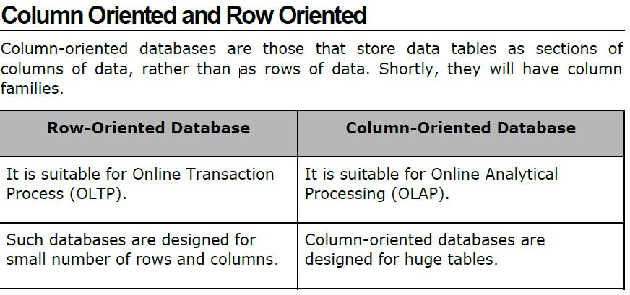
Column Versus Row
Integral Types

Slide 12
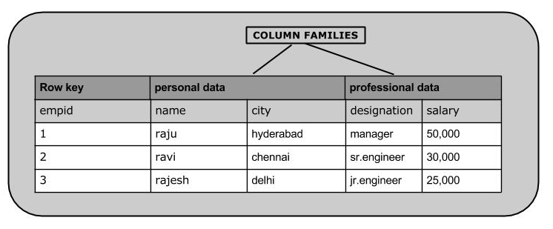
Column families

Slide 13
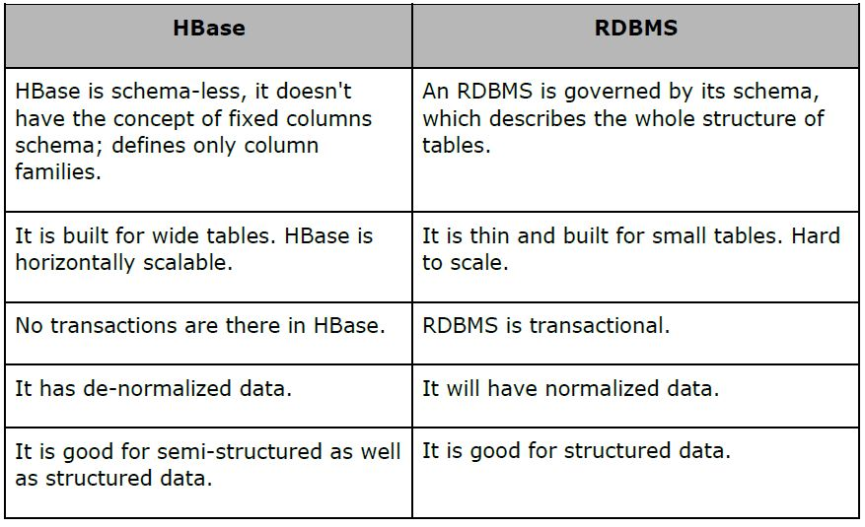
HBase and RDBMS

Slide 14
Features of HBase
HBase is linearly scalable.
It has automatic failure support.
It provides consistent read and writes.
It integrates with Hadoop, both as a source and a destination.
It has easy java API for client.
It provides data replication across clusters.

Slide 15
Where to Use HBase
Apache HBase is used to have random, real-time read/write access to Big Data.
It hosts very large tables on top of clusters of commodity hardware.
Apache HBase is a non-relational database modeled after Google's Bigtable. Bigtable acts up on Google File System, likewise Apache HBase works on top of Hadoop and HDFS.

Slide 16
Applications of HBase
It is used whenever there is a need to write heavy applications.
HBase is used whenever we need to provide fast random access to available data.
Companies such as Facebook, Twitter, Yahoo, and Adobe use HBase internally.

Slide 17
HBase Architecture
In HBase, tables are split into regions and are served by the region servers.
Regions are vertically divided by column families into “Stores”.
Stores are saved as files in HDFS.
Note: The term ‘store’ is used for regions to explain the storage structure.

Slide 18
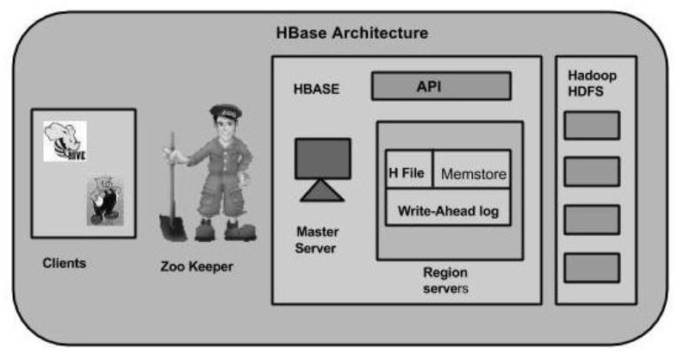
HBase Architecture

Slide 19
Hbase Components
MasterServer
The master server -
Assigns regions to the region servers and takes the help of Apache ZooKeeper for this task.
Handles load balancing of the regions across region servers. It unloads the busy servers and shifts the regions to less occupied servers.
Maintains the state of the cluster by negotiating the load balancing.
Is responsible for schema changes and other metadata operations such as creation of tables and column families.

Slide 20
Region server
The region servers have regions that -
Communicate with the client and handle data-related operations.
Handle read and write requests for all the regions under it.
Decide the size of the region by following the region size thresholds.
The store contains memory store and HFiles.
Memstore is just like a cache memory.

Slide 21
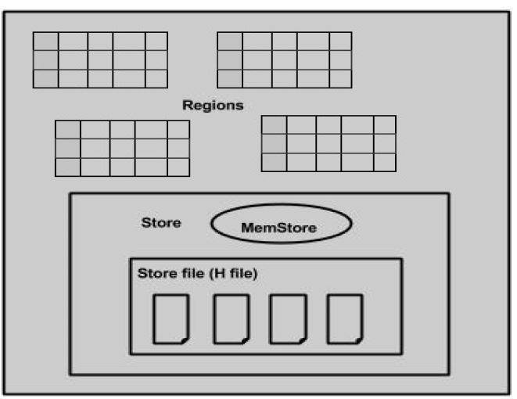
Region server

Slide 22
HBase Shell
HBase contains a shell using which you can communicate with HBase.
HBase uses the Hadoop File System to store its data.
It will have a master server and region servers.
The data storage will be in the form of regions (tables).
These regions will be split up and stored in region servers.

Slide 23
Data Definition Language
These are the commands that operate on the tables in HBase.
create: Creates a table.
list: Lists all the tables in HBase.
disable: Disables a table.
is_disabled: Verifies whether a table is disabled.
enable: Enables a table.
is_enabled: Verifies whether a table is enabled.
describe: Provides the description of a table.
alter: Alters a table.
exists: Verifies whether a table exists.
drop: Drops a table from HBase.

Slide 24
Data Manipulation Language
put: Puts a cell value at a specified column in a specified row in a particular table.
get: Fetches the contents of row or a cell.
delete: Deletes a cell value in a table.
deleteall: Deletes all the cells in a given row.
scan: Scans and returns the table data.
count: Counts and returns the number of rows in a table.
truncate: Disables, drops, and recreates a specified table.

